Slide 1
Hardware

Slide 2
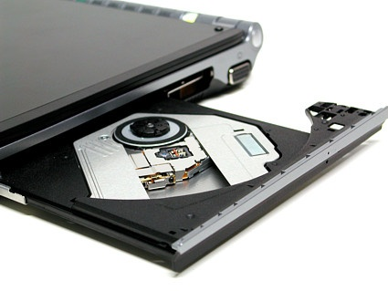
Optical Driver
A machine that reads data from and writes data onto a disk. A disk drive rotates the disk very fast and has one or more heads that read and write data.

Slide 3
Peripheral component interconnect(PCI)
A local bus standard developed by Intel Corporation
PCI defines the electrical characteristics and signal protocol used for two devices to communiate over a computer's central bus.
How does it work?
The processor is connected to the other components like the hard drives, the main memory and the PCI slots by the use of a front-side bus. The speed of the front side bus can reach up to 400 Mhz with a system operating at the speed of 800 Mhz. The backside bus usually has a quicker speed than the front-side bus but operates at the same rate as the processor itself. Though it is a detached connection, it ensures the connection between the processor and the Level 2 cache. With time, the level 2 cache was included in the main processor to make them more affordable and easier to use.

Slide 4
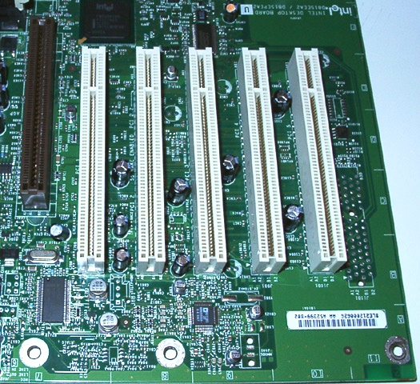

Slide 5

Accelerated Graphics Port(AGP)
AGP is an advanced port designed for Video cards and 3D accelerators.

Slide 6
network interface card(NIC)
A network interface card (NIC) is a computer circuit board or card that is installed in a computer so that it can be connected to a network.
Personal computers and workstations on a local area network (LAN) typically contain a network interface card specifically designed for the LAN transmission technology, such as Ethernet or token ring.
Network interface cards provide a dedicated, full-time connection to a network.
Most home and portable computers connect to the Internet through as-needed dial-up connection. The modem provides the connection interface to the Internet service provider.

Slide 7
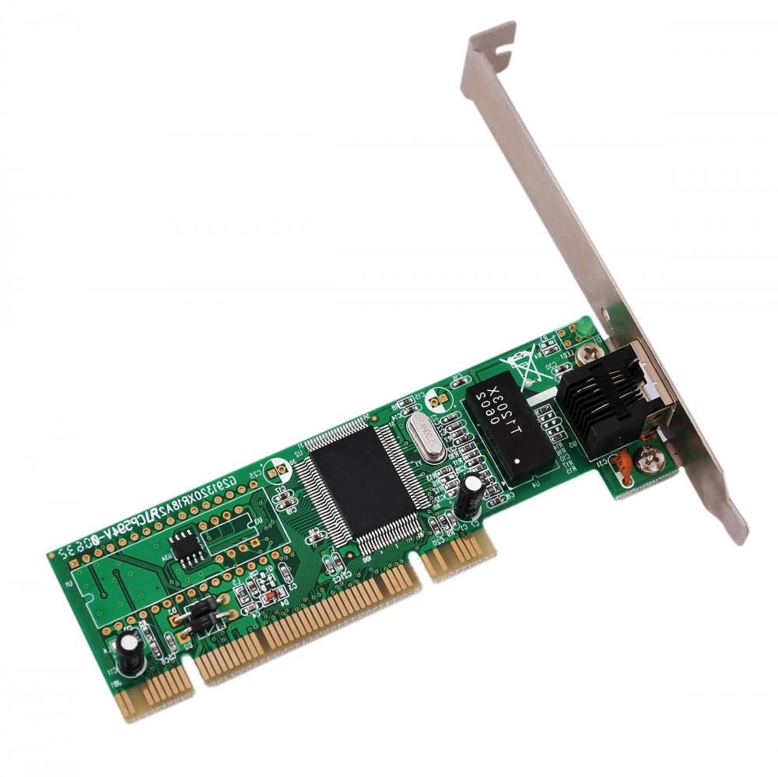

Slide 8
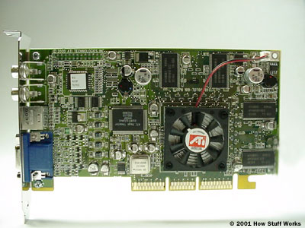
Graphics card
Graphics cards take data from the CPU and turn it into pictures.

Slide 9
modem
A modem is a device or program that enables a computer to transmit data over, for example, telephone or cable lines.
Computer information is stored digitally, whereas information transmitted over telephone lines is transmitted in the form of analog waves. A modem converts between these two forms.

Slide 10
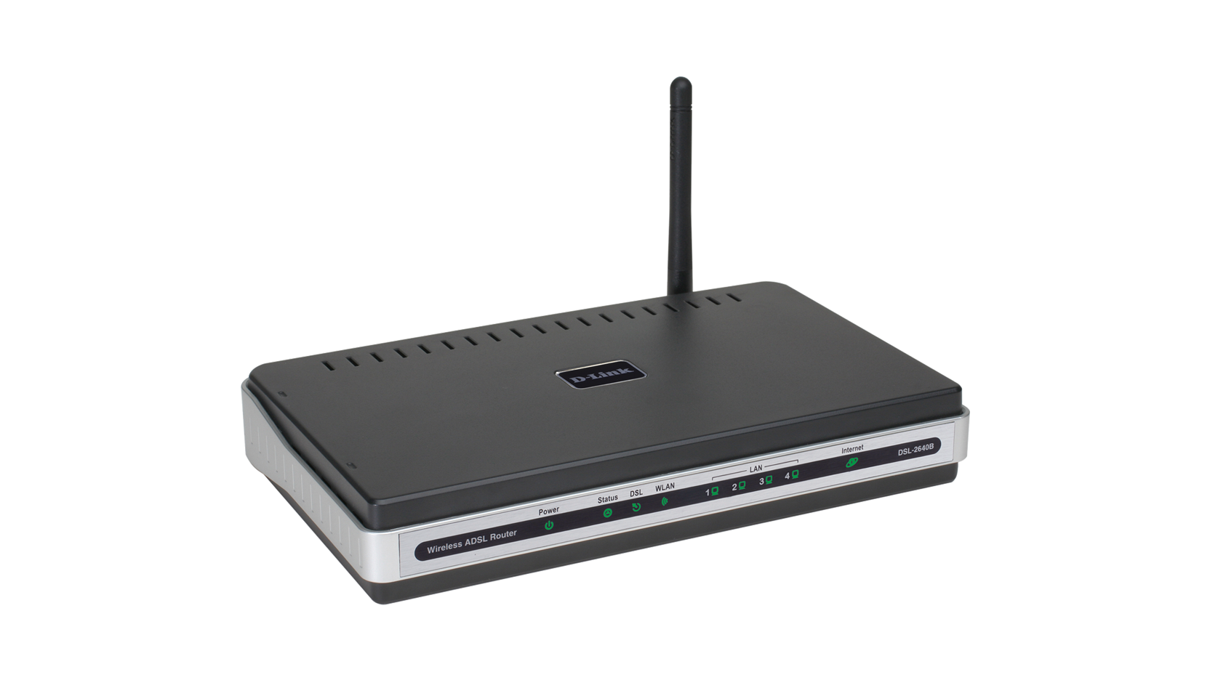

Slide 11
Sound card
An expansion board that enables a computer to manipulate and output sounds.
Sound cards enable the computer to output sound through speakers connected to the board, to record sound input from a microphone connected to the computer, and manipulate sound stored on a disk.

Slide 12
